Slide 1

Linux Internals: Exploring the Core Components

Slide 2
Agenda
Introduction
Linux Shell commands
Linux Shell Scripting
Process Management (fork, exec, clone)
Threads
IPC(Inter Process Communication)
Pipe, FIPO, msgQ, Shared Memory, Semaphores, Socket
Socket Programming
Schedular

Slide 3

Introduction
Linux:
Mention that Linux is an open-source operating system widely used in various domains, including servers, embedded systems, and even smartphones.
Emphasize its reputation for stability, security, and flexibility.
Importance of Understanding Internals:
Explain that gaining insights into Linux internals allows users to grasp how the operating system functions at a deeper level.
This understanding enables individuals to optimize system performance, troubleshoot issues, and develop customized solutions tailored to specific requirements.

Slide 4
Linux Shell Scripting
In the simplest terms, a shell script is a file containing a series of commands. The shell reads this file and carries out the commands as though they have been entered directly on the command line.
Example-
$ echo '#!/bin/sh' > my-script.sh
$ echo 'echo Hello World' >> my-script.sh
$ cal
$ sh script.sh
$ time
Shell scripts typically start with a shebang (#!) to specify the shell interpreter (e.g.,
#!/bin/bash).
Standard input, output, and error streams (stdin, stdout, stderr) can be redirected using symbols (e.g., >, >>, <).
Concepts:-Variables and Data Types, Control Structures, Command Line Arguments, Input and Output, Functions, Error Handling and Script Debugging.

Slide 5
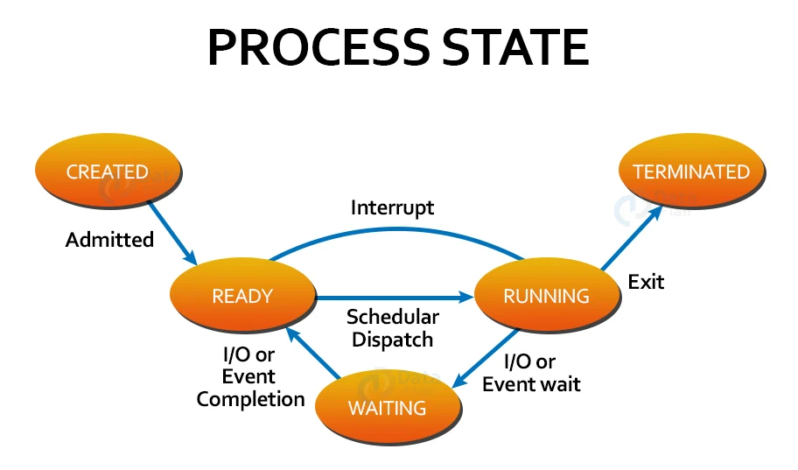
Process Management (fork, exec)
Process management in Linux involves creating and controlling processes, which are instances of running programs.
Three key operations for process management are fork, exec, and clone.

Slide 6
Process Management
fork(): Creates a new process by duplicating the existing process.
After fork system call both child and parent executed simultenously.
Child & parent have unique process ID.
exec(): Replaces the current process image with a new process image.
Control is never transferred to original program unless there is an error.
New Program is loaded in the current process ID remains same.
wait(): Suspends execution of the calling process until one of its child processes terminates.
kill(): Sends a signal to a specified process or process group.
getpid(): Returns the process ID of the calling process.

Slide 7
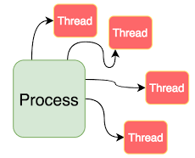
Threads
What is Threads?
Thread is an execution unit that is part of a process. A process can have multiple threads, all executing at the same time. It is a unit of execution in concurrent programming. A thread is lightweight and can we managed independently by a scheduler.
It helps you to improve the application performance using parallelism.
Multiple threads share information like data, code, file, etc. We can implement threads in two different ways:
pthread_create():The pthread_create() function is used to create a new thread within a process.
pthread_exit():The pthread_exit() function is used to terminate the calling thread and return a value to its parent thread or the process.
Pthread_detach(), pthread_join(), pthread_cancel().

Slide 8
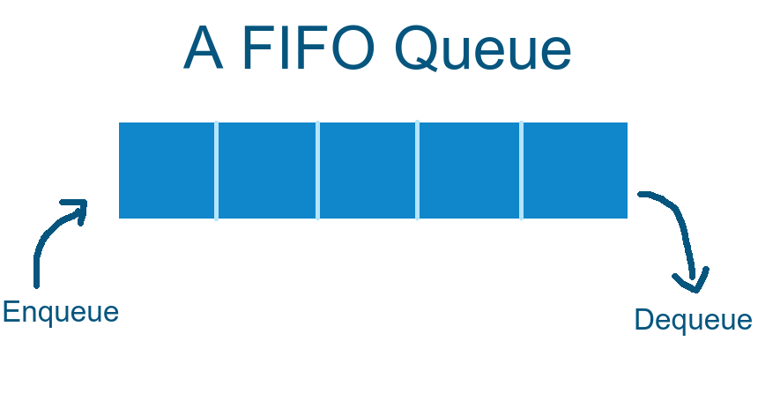
IPC(Inter Process Communication)
IPC in Linux facilitates communication and data exchange between processes, enabling collaboration, synchronization, and coordination.
IPC Mechanism :
FIFO
Pipes
Message Queues
Shared Memory
Semaphore
FIFO :
A first-in, first-out file is a pipe that has a name in the file system.
It also called named pipes.
When a blocked SCHED_FIFO thread becomes runnable, it will be inserted at the end of the list for its priority.
FIFOs have both a read end and a write end, allowing processes to communicate by writing and reading from the FIFO.

Slide 9
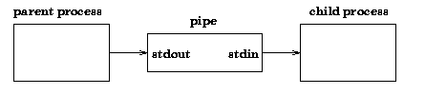
IPC(Inter Process Communication)
Pipe :
Unidirectional communication channels between related processes, with one process writing to the pipe and the other reading from it.
Data written to the write end of the pipe by one process can be read from the read end of the pipe by another process.
Pipes follow a First-In-First-Out (FIFO) order, meaning that the data is read from the pipe in the same order it was written.

Slide 10
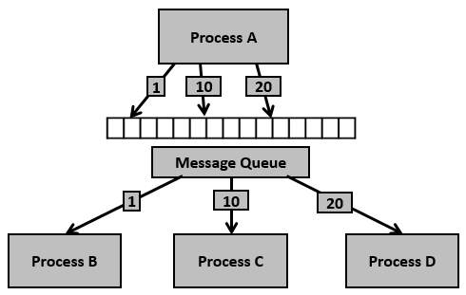
Message Queue :
Message queue is a mechanism for interprocess communication (IPC) that allows processes to exchange messages in a predefined format.
It provides a way for processes to communicate and synchronize by sending and receiving messages through a message queue.
Message queues provide synchronization capabilities by allowing processes to block until a message becomes available in the queue.

Slide 11
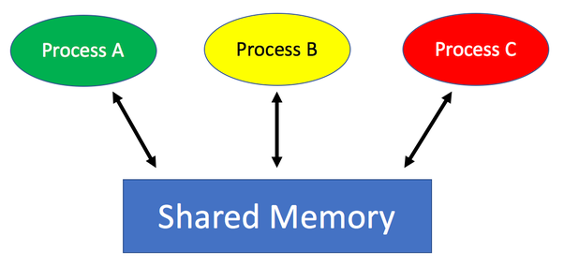
IPC(Inter Process Communication)
Shared Memory :
Shared memory is a mechanism for interprocess communication (IPC) that allows multiple processes to share a common area of memory.
It enables efficient data exchange between processes by providing a shared region where data can be read from and written to by different processes.
When one processes changes the memory, all the other processes see the modification.

Slide 12
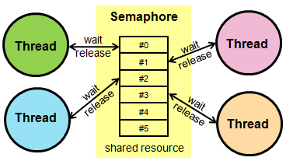
IPC(Inter Process Communication)
Semaphores :
semaphores are synchronization mechanisms used for interprocess communication (IPC) and process synchronization.
Semaphores provide a way for processes to coordinate their activities and protect shared resources by controlling access to critical sections.
By using semaphores, processes can coordinate their activities and avoid race conditions where multiple processes try to access the same resource simultaneously.

Slide 13
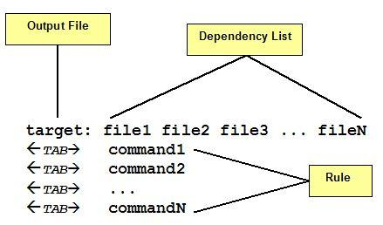
Makefile
A Makefile is a special file used by the make utility in Linux to automate the building, compiling, and linking of software projects.
It contains a set of rules that define the dependencies between source code files and the commands needed to generate the desired output, such as an executable file or a library.
Targets:
A target represents a file or a logical goal that needs to be built. It can be an executable, an object file, or any other desired output.
Dependencies:
Dependencies are files that a target depends on. If a dependency changes, it indicates that the target needs to be rebuilt.
Variables:
Variables are used to store values that can be reused throughout the Makefile. Ex:- $@, $*, $< ,$>
Phony Targets:
Phony targets are targets that do not represent actual files but serve as a convenient way to execute specific actions. Ex :- clean,install .

Slide 14
Nested Makefile
The nested Makefile structure consists of a parent Makefile and multiple subdirectory Makefiles.
Each subdirectory has its own Makefile, which handles the build process for that specific component or subdirectory.
The parent Makefile coordinates the build process by invoking the sub-Makefiles.
# Compiler and compiler flags
CC = gcc
OFLAG=-o
CFLAG=-c –g
APP: app.c print.c add.c header.h
$(CC) $^ $(OFLAG) $@
(gcc app.c print.c add.c -o APP)
Clean: rm –rf *.o APP
Parent
All clean tip: } multiple target
cd src && $(MAKE) $@
Child
all:tip
tip: app.c
gcc app.c –o APP
Clean: rm –rf APP

